Slide 1


Slide 2

UNION COUNTY PUBLIC SCHOOLS
53 Schools
Approximately 42,000 students

Slide 3


ACHIEVEMENTS
9
SPLASH
IMMERSIONS
1 Leader in Me Lighthouse School
3 National Blue Ribbon Schools
9 A+ Schools of Distinction
67 Team State Championships
QUALITY SCHOOLS
92.8%
GRADUATION
RATE
FISCALLY
RESPONSIBLE
INNOVATIVE
TEACHING
AND LEARNING
LEADERS
$111.2 M
SCHOLARSHIPS
CLASS OF 2016

Slide 4

UCPS BOND HISTORY
2000-2004-2006
Bonds resulted in 23
New School Construction Projects:
Weddington High
Antioch Elementary
Fairview Elementary
Kensington Elementary
Marvin Elementary
Sandy Ridge Elementary
Walter Bickett Elementary
Porter Ridge Elementary
Porter Ridge Middle
Porter Ridge High
Rock Rest Elementary
Rea View Elementary
CATA
New Town Elementary
Rocky River Elementary
New Wolfe School
Marvin Ridge Middle
Marvin Ridge High
Stallings Elementary
Sun Valley Elementary
Poplin Elementary
Cuthbertson Middle
Cuthbertson High

Slide 5
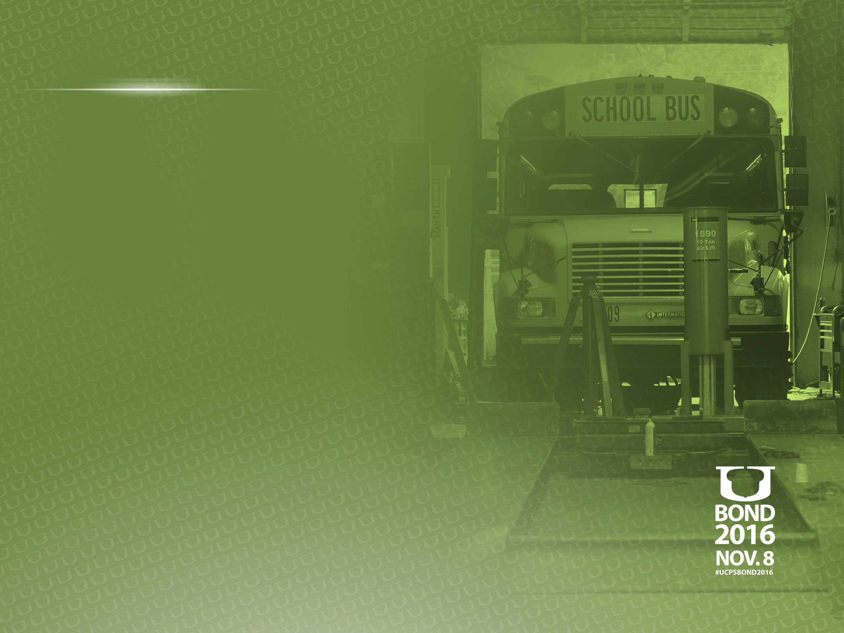
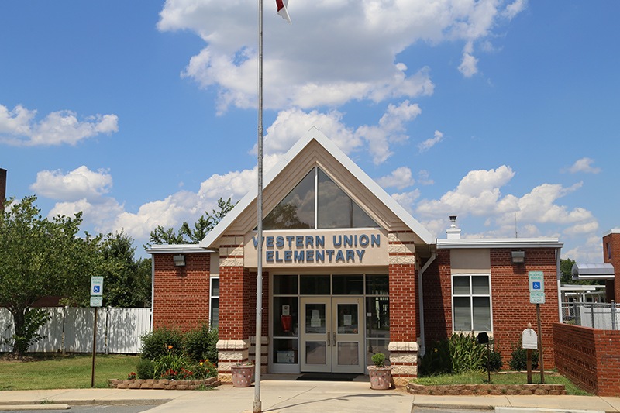
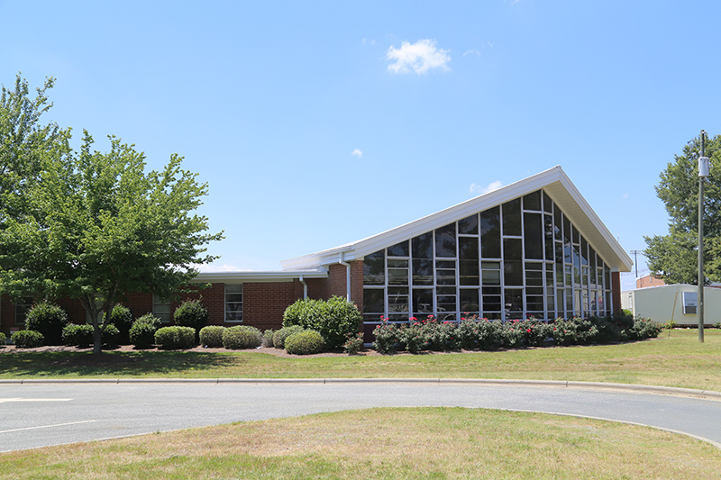
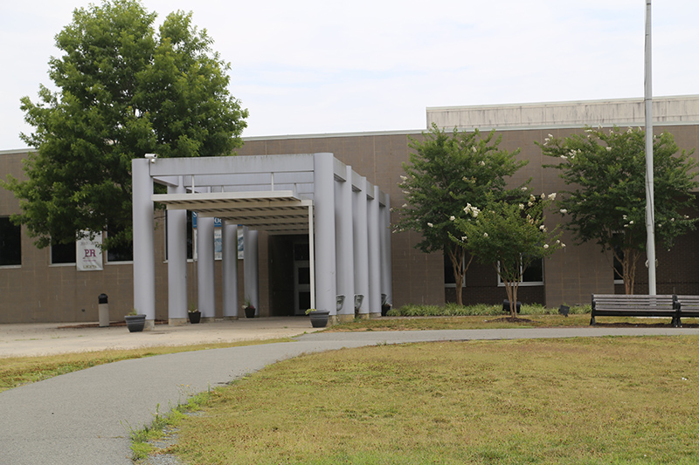
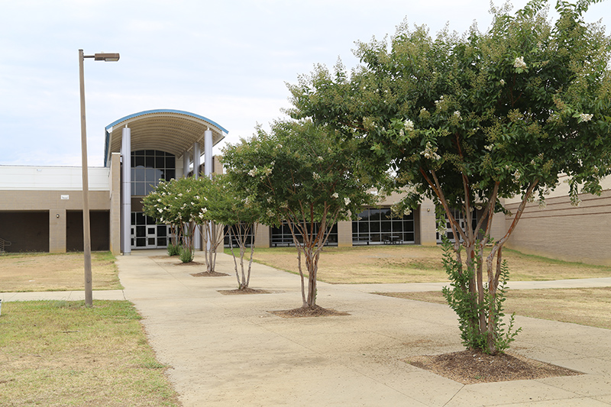
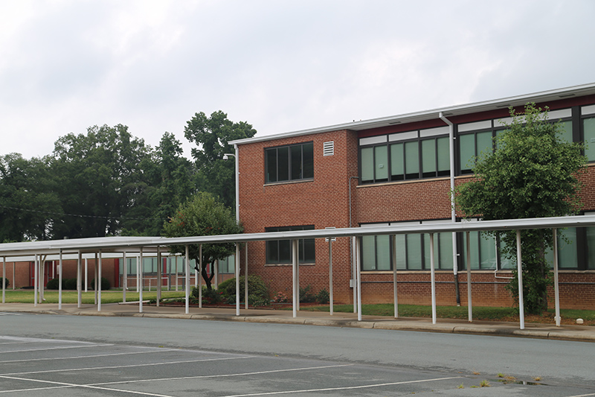
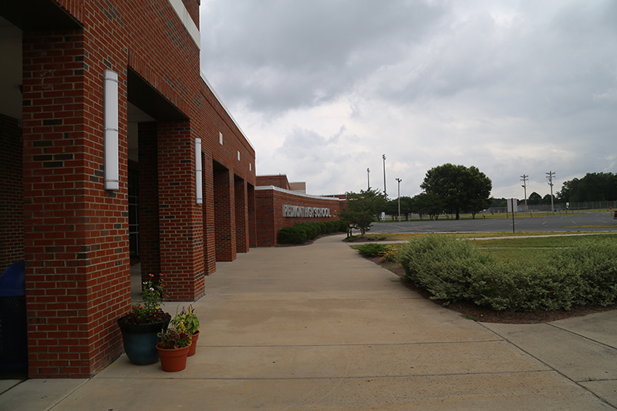
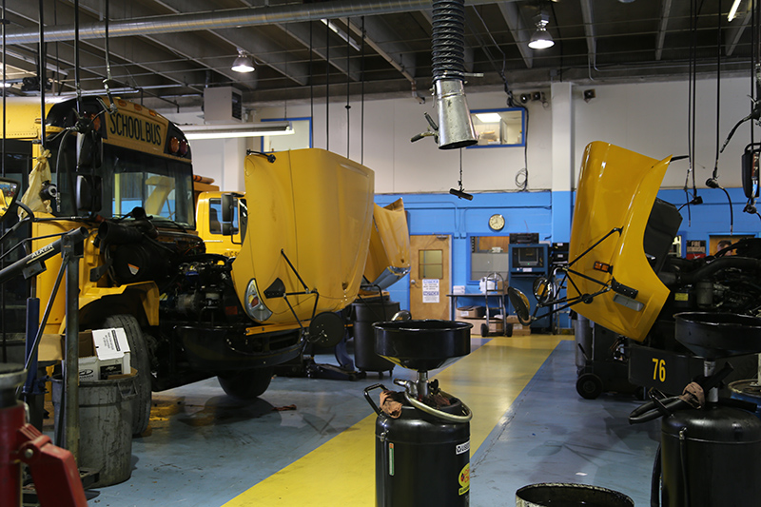
UCPS Bond 2016
On Nov. 8, voters will decide on
$54 million in school bonds.

Slide 6
WHY DO WE NEED THIS BOND?
Increase capacity for 6 schools nearing CAP
Sustain growth through 2025-26
Address safety repairs and ADA
Renovate aging facilities
Remove aging mobile classrooms
Construct New Transportation Facility with adequate service bays and parking

Slide 7

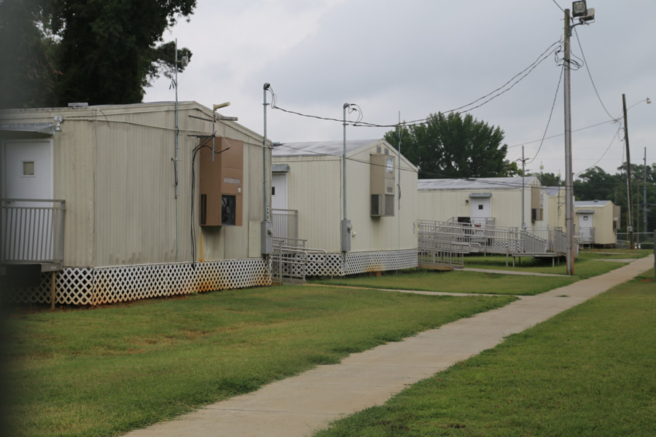
2016 BOND PROJECTS
MONROE HIGH
8 Classrooms
2 Teacher Workrooms
2 Teacher Offices
Additional Storage
Increase School Capacity to 1,500 (Maximum)
13 Mobile Classrooms
Built in 1960
^{$3,452,760}

Slide 8
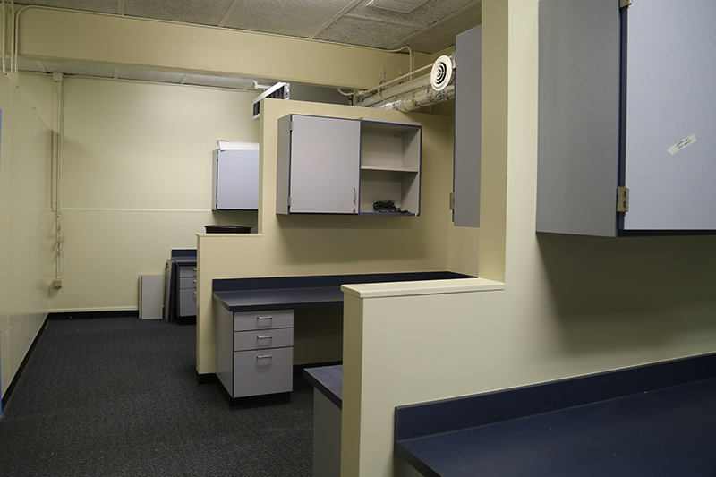
2016 BOND PROJECTS
PIEDMONT HIGH
4 Classrooms
2 Teacher Offices
2 Teacher Workrooms
Additional Storage
Increase School Capacity to 1,600 (Maximum)
Built in 1960
^{$2,148,384}

Slide 9
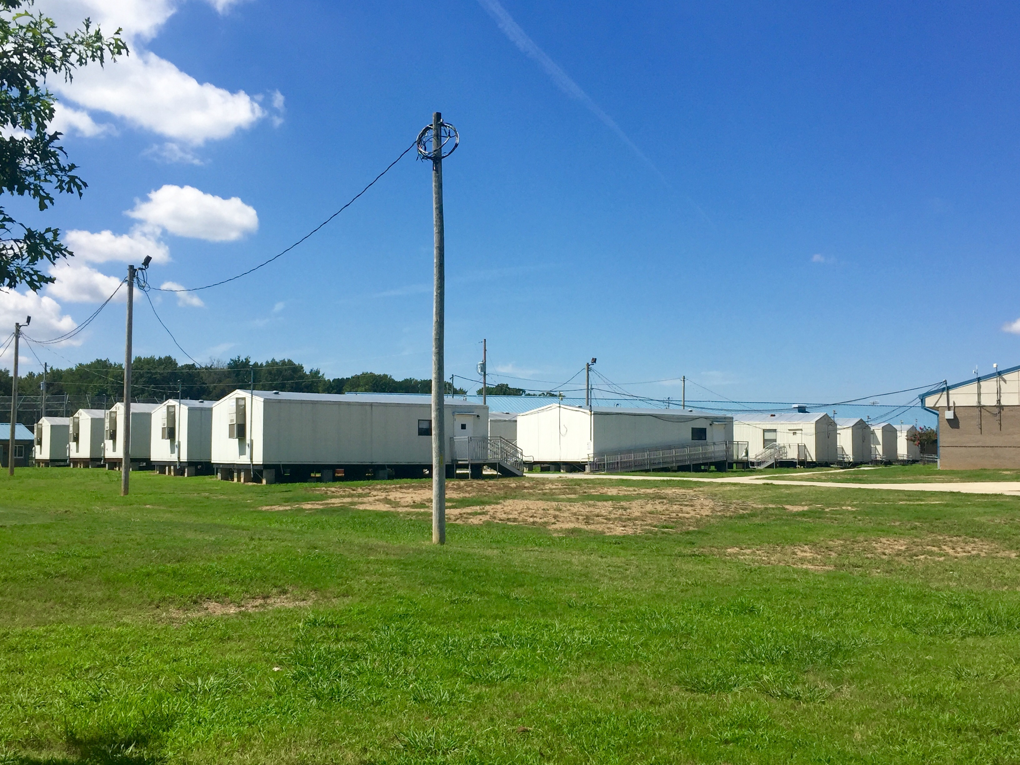
2016 BOND PROJECTS
PORTER RIDGE MIDDLE
15 Classrooms
2 Teacher Workrooms
Expand Media Center
Additional Storage
Increase Student Capacity to 1,600 (maximum)
21 Mobile Classrooms
Built in 2005
^{$6,272,514}

Slide 10
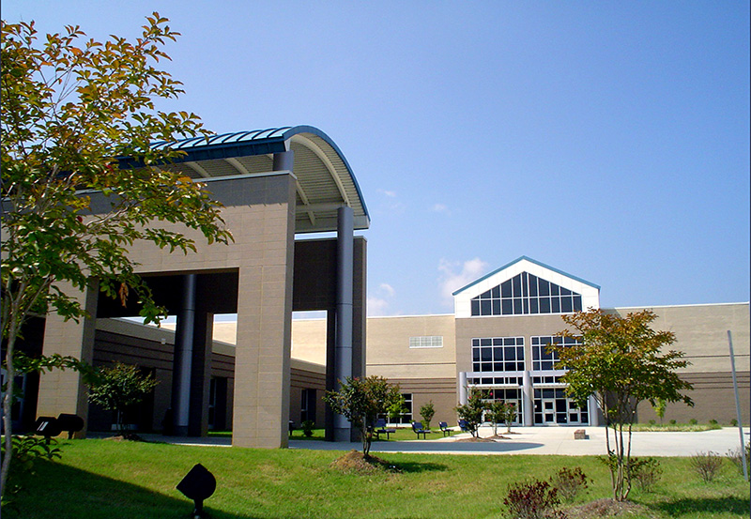
2016 BOND PROJECTS
PORTER RIDGE HIGH
4 Classrooms
Expand Cafeteria
Increase Student Capacity to 1,800 (Maximum)
Built in 2005
^{$1,496,196}

Slide 11
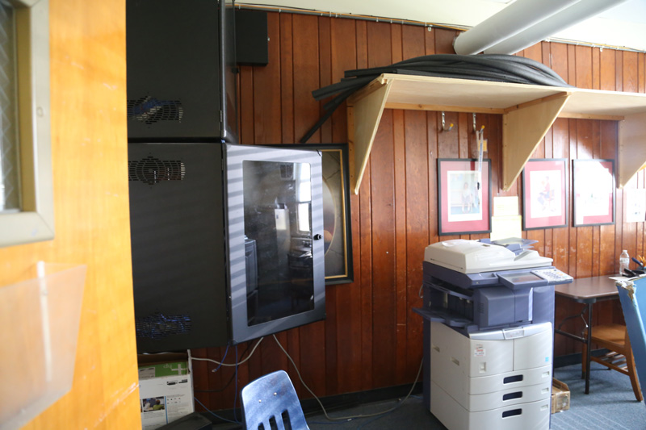
2016 BOND PROJECTS
WESTERN UNION ELEMENTARY
8 Classrooms
Expand cafeteria
2 Teacher Workrooms
Remove Mobile Units (3)
Increase Student Capacity to 804 (maximum)
Built in 1955
^{$3,882,437}

Slide 12
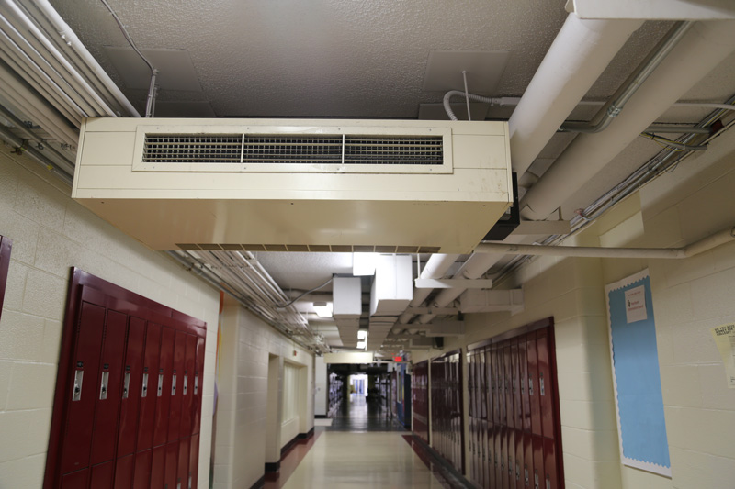
2016 BOND PROJECTS
SUN VALLEY HIGH
10 Classrooms
Auditorium Renovation
Expand Administrative Office Area
Expand Media Center
Add Teacher Workrooms
Expand Cafeteria and Kitchen
New Chorus Room
HVAC and Plumbing Upgrades
^{$24,364,734}

Slide 13
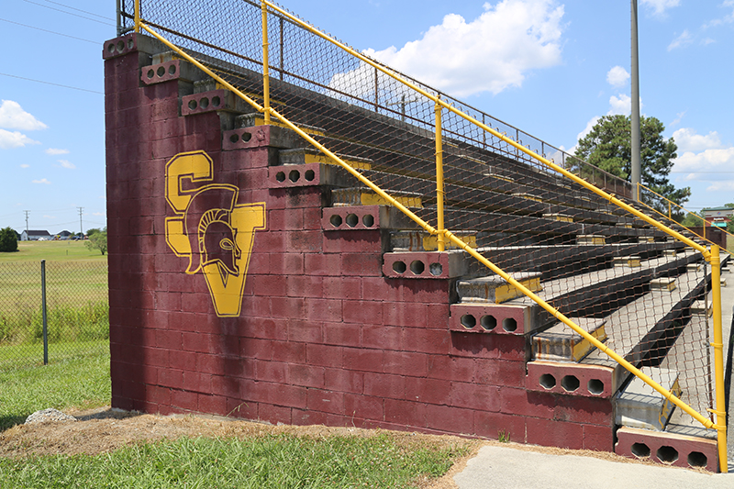
2016 BOND PROJECTS
SUN VALLEY HIGH
ADA Renovations
Remove Mobile Units
Increase Student Capacity to 1,800 (maximum)
New Athletic Stadium
Built in 1960
^{$24,364,734}

Slide 14
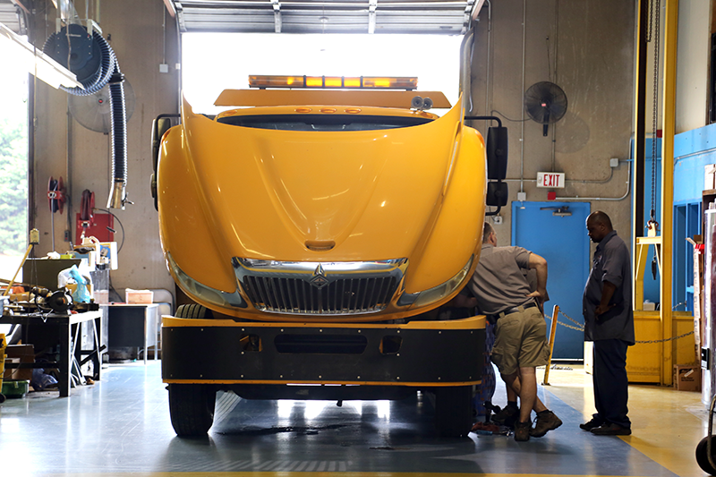
2016 BOND PROJECTS
TRANSPORTATION FACILITY
New Facility on Gold Mine Road
50,723 s.f. Facility w/ Office Space
Increase to 16 Bays
Parts and Storage Areas
Secure Parking
Current Facility does not meet DPI Recommendations
Current Facility Built 1980
^{$12,000,000}

Slide 15


2016 BOND PROJECTS
Tax Impact $54 Million Bond
Estimated Tax Increase
$.16 cents per $1,000
For example, if you have a house that is worth $100,000, then your tax increase for this portion of the bond is approximately $16 annually.
*Source Union County Board of County Commissioners

Slide 16
2016 BOND PROJECTS
How Can Bond Funds Be Spent?
Proceeds from a bond issue can only be used for the costs associated with:
  Construction and renovation of facilities
  Acquisition of land
  Purchase of capital items
Bond proceeds cannot be used for teacher salaries.

Slide 17

FREQUENTLY ASKED QUESTIONS
Q. Why do we need a new Transportation Facility?
The facility on Venus Street was built in 1980.
The facility does not meet the Department of Public Instruction’s recommendation for a fleet our size. The current facility has 6 maintenance bays.
The new facility will have at least 16 bays.
UCPS has more than 400 buses in its entire fleet. Each day, approximately 300 buses travel more than 29,000 miles, transporting 31,000 students.

Slide 18
FREQUENTLY ASKED QUESTIONS
Q. How were these 6 schools chosen?
The Board of Education recommended these projects to the BOCC after a comprehensive list failed. These 6 schools were identified based on Enrollment Forecasts and McKibben data through 2025-26. Western Union, SVHS, PRMS, PRHS, Piedmont HS, and Monroe HS will soon exceed current school capacities causing overcrowding, larger class sizes, and possible capping.

Slide 19
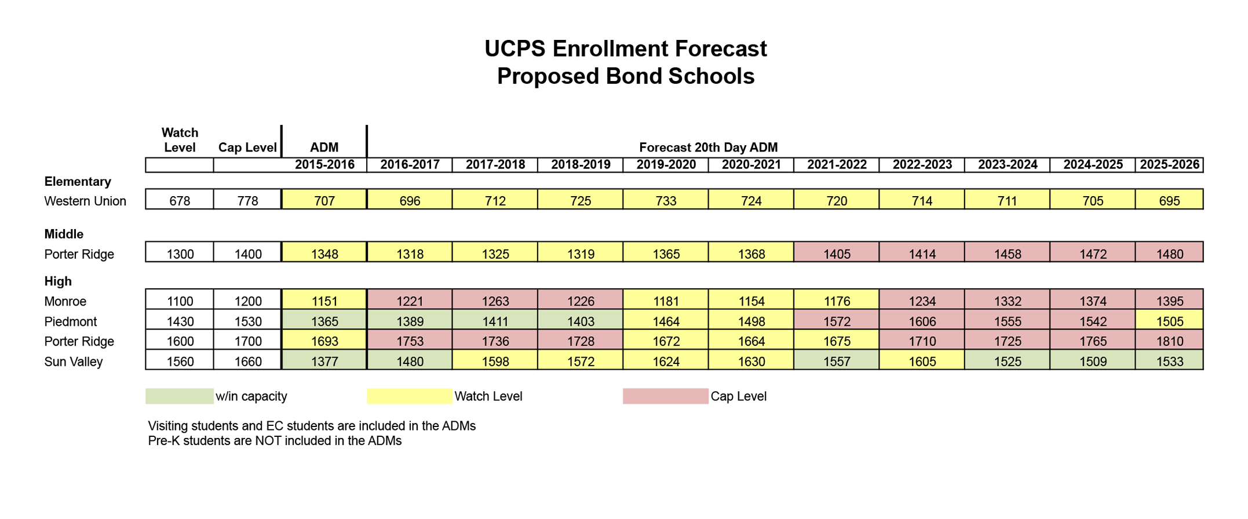
FREQUENTLY ASKED QUESTIONS
Q. What was the 2015-16 enrollment forecast for the 6 schools on the bond list?
A.

Slide 20
FREQUENTLY ASKED QUESTIONS
Q. How will community members and school stakeholders be engaged in bond projects?
Each school with a bond project will have a Project Advisory Team that will participate in the planning and design of the additions and renovations. This team will consist of parents, community members, students, teachers and administrators.

Slide 21
FREQUENTLY ASKED QUESTIONS
Q. My child’s school is not on the list, why should I be concerned with renovations, additions and a new transportation facility?
Union County residents value quality schools and adequate learning environments. When school capacities are properly managed and planned for, it benefits the entire county. Previous bonds were approved for new schools/renovations between 2000 and 2009. Supporting this bond allows UCPS to increase school capacity in high growth areas and creates county wide stability through 2025-26.

Slide 22
FREQUENTLY ASKED QUESTIONS
Q. What happens if this bond doesn’t pass?
The Board of Education will have to work with the county to develop an alternate plan to address overcrowding, larger class sizes, aging facilities, and ADA renovations. Other schools waiting for Capital Improvements will be delayed.

Slide 23
FREQUENTLY ASKED QUESTIONS
Q. When will my school get needed improvements?
This bond referendum is separate from our annual Capital Improvement Plan and will allow other schools to move up the list for needed repairs.
Capital Improvement Plan (CIP)

Slide 24


VOTING INFORMATION
  Voter registration is open
  Early voting runs October 20 – November 5
  For more information about voting: http://www.co.union.nc.us/government/boardofelections

Slide 25
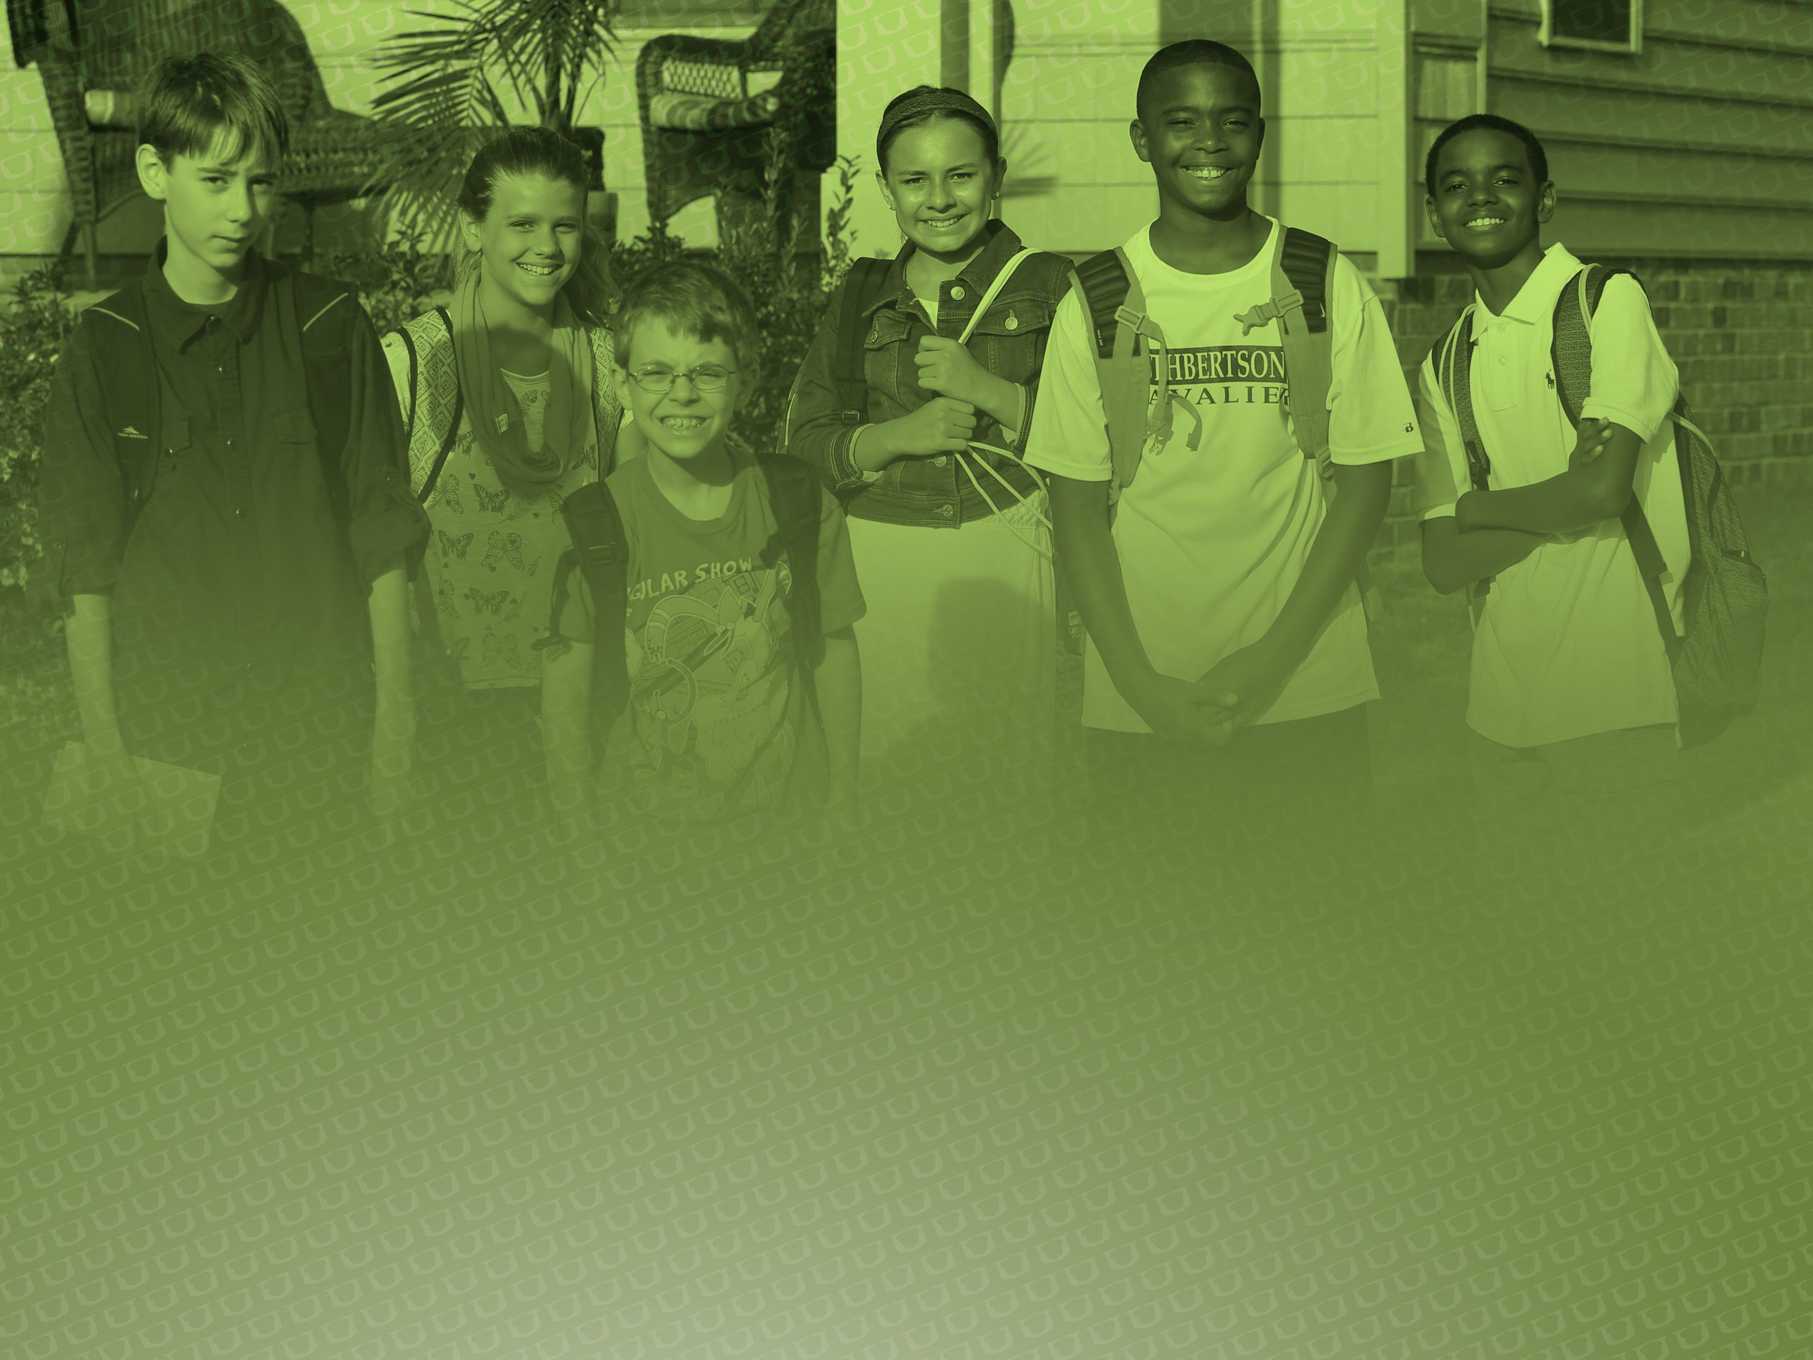
www.ucps.k12.nc.us
#UCPSBOND2016
ucpsbond2016@ucps.k12.nc.us

