Slide 1
HOW TO AVOID PLAGIARISM
Presented By
Marvin Ridge High School
Media Staff

Slide 2
This presentation complies with the Fair Use laws of the U.S.

Slide 3
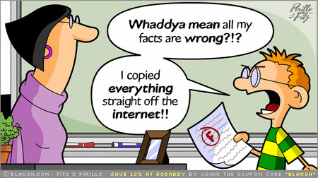
Image Source: http://4.bp.blogspot.com/-P8P5B56gI3c/TWHMV4bcLlI/AAAAAAAAA3M/2idEvlCXcwM/s1600/Plagiarism+comic.gif

Slide 4
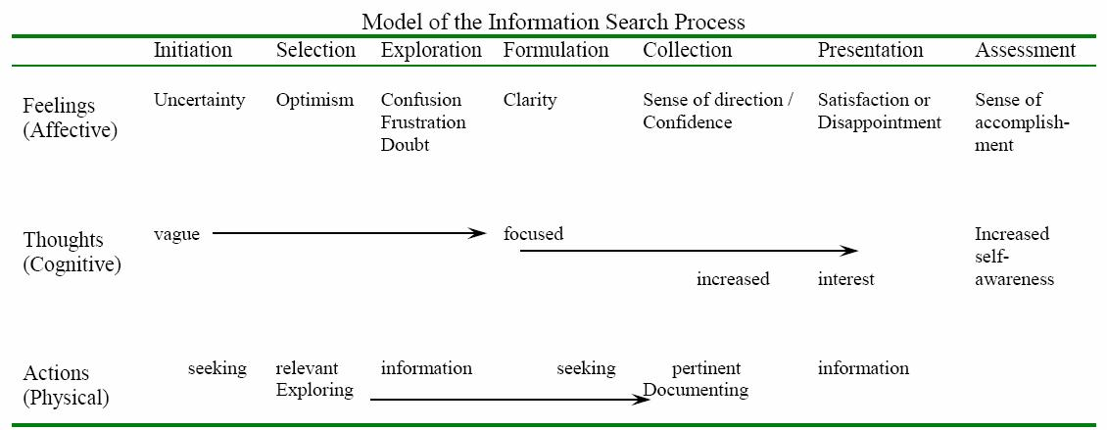
The Information Search Process – Carol Kuhlthau
Kuhlthau, C. (2004)

Slide 7
* I will complete assignments in a timely and professional manner, including readings, forum discussions, etc. I will submit only my original work for this semester and not the work of other students, persons, or sources. I will cite sources when using ideas from other persons and not be guilty of plagiarism. I will not recycle previous assignments

Slide 8
PLAGIARISM – What is it??
“The unauthorized use or close imitation of the language and thoughts of another author and the representation of them as one's own original work.”
Plagiarism is the act of stealing ideas, language and information and passing them off as one’s own. Although research requires us to refer to another person’s ideas, we must reference these ideas and give credit to the sources where we found this information.
(http://www.arlington.k12.ma.us/ahs/docs/plagarism.pdf)

Slide 9
Examples of Plagiarism
Paying someone to complete your assignment
Failing to use footnotes and/or a bibliography
Cutting and pasting from the internet
Copying from a printed book
Copying from a friend

Slide 10
How do you AVOID Plagiarism?
Direct quotations
Paraphrasing
Includes summarizing and referencing the works of others within your paper or project
Even when paraphrasing – YOU STILL MUST CITE!

Slide 11
What Do I Need to Cite?
Did you
think of
it?
This chart will help you decide what must be cited
It was created by Robert A. Harris in The Plagiarism Handbook
(from Mt Lebanon School District Media page http://www.mtlsd.org/highschool/highschoolplagiarismlessons.asp)
Yes.
No.
Is it
common
knowledge?
Yes.
No.
Cite it.
Do not cite it.

Slide 12
Did you
think of
it?
Yes.
So – the rule is:
If you created it, you do not need to cite the source
If you did not create the content, you must cite the source
No.
Is it
common
knowledge?
Yes.
No.
Cite it.
Do not cite it.

Slide 13
Exception!
You do not need to cite common knowledge
You do not need to cite the source of an unoriginal piece of information IF
An educated person should know the information
OR
It is a provable fact that could be found in a general encyclopedia

Slide 14
Example
Jennifer Lawrence is the actress who plays Katniss Everdeen in The Hunger Games
(don’t have to cite this – well-known fact)
Amandla Stenberg (2012) states “Jen has some of Katniss’ qualities in her.”
(cite the source of any ideas that are not your own, and any time you use the exact words of the source)

Slide 15
Why Should You Bother?
Four good reasons for citing sources in your work:
Citing reliable information gives credibility to your work
Cheating is unethical behavior
It is only fair to give credit to the source – otherwise, you are stealing the source’s ideas
The consequences are severe – plagiarism is not worth the risk!
(from Mt Lebanon School District Media page http://www.mtlsd.org/highschool/highschoolplagiarismlessons.asp)

Slide 16
Real Life Consequences
Joe Biden – forced to quit the 1988 presidential race due to allegations of plagiarism throughout law school
(http://www.nytimes.com/1987/09/18/us/biden-admits-plagiarism-in-school-but-says-it-was-not-malevolent.html)
Michael McAdoo – UNC-Chapel Hill football player received an F in a course, academic probation and academic suspension. Kept off the football team.
(http://www.newsobserver.com/2011/07/17/1349691/mcadoo-paper-case-looks-bad-for.html)
Kaavya Viswanathan – Harvard University student published debut novel How Opal Mehta Got Kissed, Got Wild, and Got a Life. Found out she plagiarized (cut & paste from other novels) – book was recalled and sequel was cancelled
(http://www.strose.edu/academics/academic_integrity/article3218)
Melissa Elias – President of Madison School Board, NJ plagiarized a commencement speech. Forced to resign.
(http://www.strose.edu/academics/academic_integrity/article3218)

Slide 17
How to Cite
MLA or APA ?
Purdue Owl – USE IT!
https://owl.english.purdue.edu/owl/
MLA uses parenthetical citation – placing relevant source information in parenthesis after a quote or paraphrase
Follows the author-page method of in-text citation
This means that the author’s last name and page number must appear in the text, and a complete reference should appear on your Works Cited page

Slide 18
Examples
Wordsworth stated that Romantic poetry was marked by a "spontaneous overflow of powerful feelings" (263). Romantic poetry is characterized by the "spontaneous overflow of powerful feelings" (Wordsworth 263).
Wordsworth extensively explored the role of emotion in the creative process (263).
(from Purdue Owl https://owl.english.purdue.edu/owl/resource/747/02/)

Slide 19
Review
When do you use in-text citations?
Do you have to cite when you put things in your own words?
What is included in the in-text citation?
What is the last page of your paper called that contains all your sources?

Slide 20
Works Cited
Dionne, E. J. “Biden Admits Plagiarism in School but Says it was not Malevolent”
The New York Times. 18 Sept 1987: Web.
Harris, Robert A. The Plagiarism Handbook: Strategies for
Preventing, Detecting, and Dealing with Plagiarism. Pyrczak Publishing: Los Angeles, 2001. Print.
Kane, Dan. “UNC Honor Court Failed to Find McAdoo’s Obvious
Plagiarism.” News & Observer. 17 July 2011: Web.
Kramer, Michelle. Mt. Lebanon High School Library. Mount Lebanon
School District, (2014). Web. 06 Nov. 2014.
Kuhlthau, Carol C. Seeking Meaning: A Process Approach to Library
and Information Services, 2nd edition, Libraries Unlimited, Westport, CT., 2004. Print.
Wordsworth, William. Lyrical Ballads. London: Oxford UP, 1967.
Print.

